Slide 1
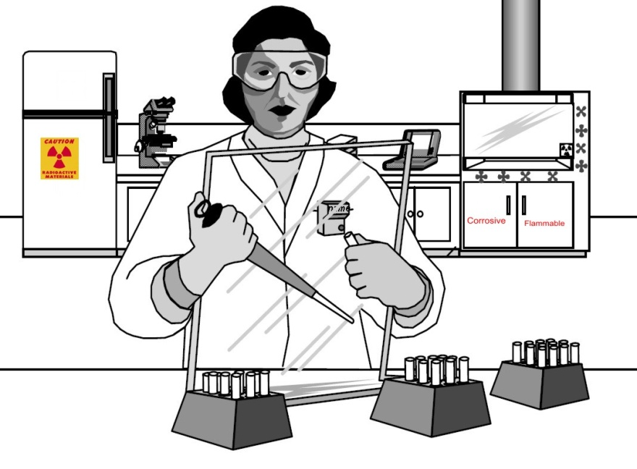

Radiation Safety
Annual Training for Radiation Workers
RSO – Margaret Smallbrock

Slide 2
USD NRC License
The US Nuclear Regulatory Commission (NRC) licenses the SD Mines to use radioactive material in research.
The license number is: 40-27640-01
You may receive additional radiation exposure from research at SD Mines.
In order to keep this exposure As Low As Reasonably Achievable (ALARA), the NRC requires training, workplace surveys, inventories, etc.

Slide 3
Ionizing Radiation
Ionizing radiation is produced by the natural decay of radioactive material.
Beta, gamma, and x-rays are forms of ionizing radiation that are often used in research.
Beta, gamma, x-rays
remove electrons
from atoms
(Ionization).
Ions are created,
which are more
chemically
reactive than
neutral atoms.
Ions can form
compounds that might
interfere with cell
division and metabolism
or cause chemical
changes in tissue.

Slide 4
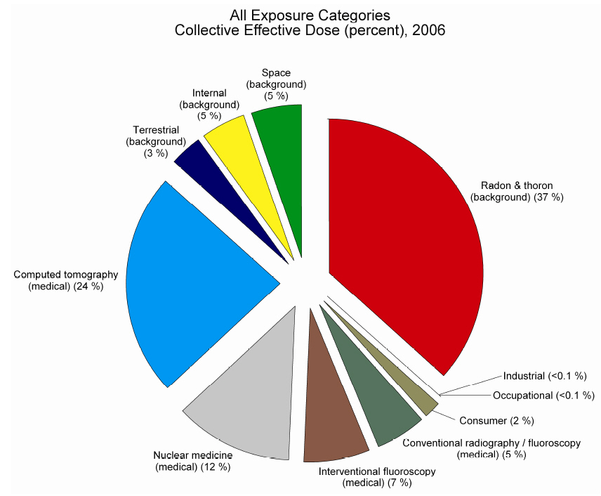
Background Radiation
Every person is exposed to radiation
Average about 620 mrem/yr from all sources
Natural background: ~ 310 mrem/yr
Man-made sources: ~ 310 mrem/yr

Slide 5
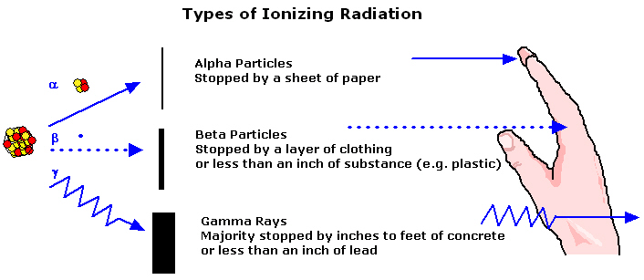
Radiation Exposure
Your exposure is related to the radiation energy
 & low energy  (energy < 300 keV) – no external exposure
High energy  (energy > 300 keV) – skin exposure possible
 – very penetrating, just like x-rays

Slide 6
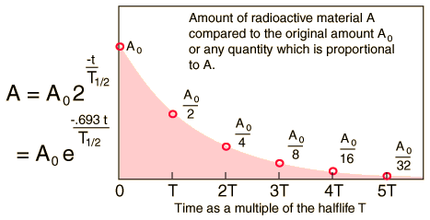
Half-life
Length of time for half the atoms to decay, after
  1 half-life, 1/2 remains
  2 half-lives, 1/2 x 1/2 = (1/2)² = 1/4 remains
  3 half-lives, 1/2 x 1/2 x 1/2 = (1/2)³ = 1/8 remains
  n half-lives, (1/2)^{n} remains

Slide 7
Radioisotopes at USD
Radioactive elements have unique decay energy & half-life
  H-3 ⁻ 18.3 keV 12.3 yr
  C-14 ⁻ 156 keV 5730 yr
  P-32 ⁻  1710 keV 14.3 day
  S-35 ⁻    167 keV 87.2 day
  P-33 ⁻    249 keV 25.3 day
  Ca-45 ⁻    258 keV 162.7 day
  Cr-51  320 keV 27.7 day
  Rb-86 ⁻  1775 keV;  1076 keV 18.66 day
  I-125  35.5 keV 60.1 day
  U-238  4196 keV; x-ray 30 keV 4,468,000,000 yr
High energy beta has more than 300 keV
Large quantities, more than 1 mCi

Slide 8
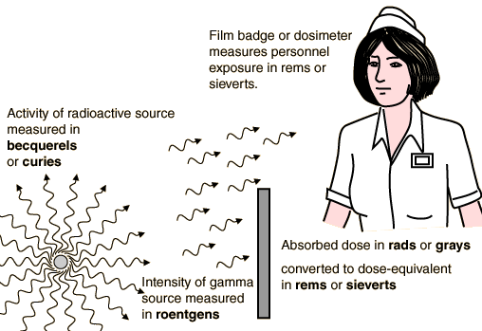
Radiation Units
Activity – Becquerel (1 dps), Curie (3.7 x 10¹⁰ dps)
Exposure in Air– Roentgen
Absorbed Dose – Gray / rad
(1 rad = 100 erg/gm; 1 Gy = 1 J/kg; 1 Gy = 100 rad)
Dose Equivalent – Sievert, rem (1 Sv = 100 rem)

Slide 9
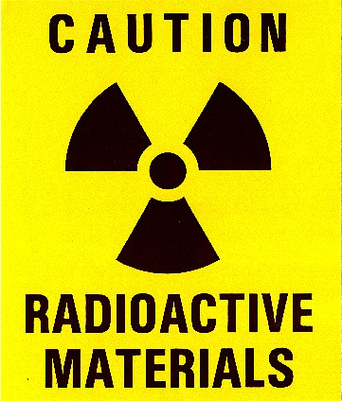
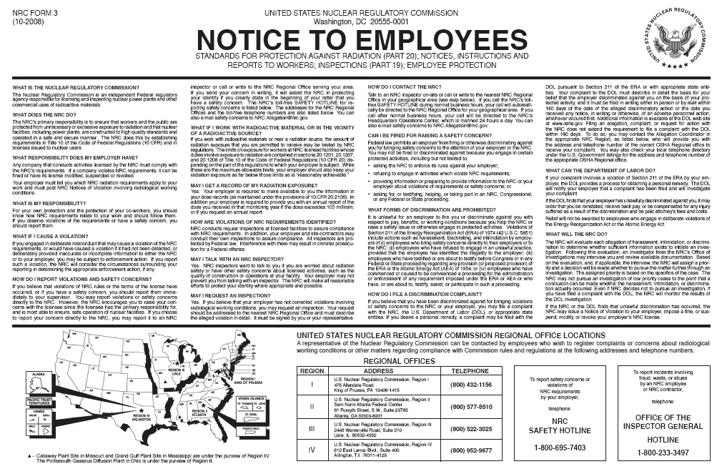
Signs & Postings
Must post all rooms with warning signs
Rooms, refrigerators, storage cabinets, radioactive equipment
  yellow & black or - yellow & magenta
Post NRC form 3 near the lab

Slide 10

Security / Surveillance
Radioactive material must be kept under direct supervision, in locked storage (e.g., locked cabinet or refrigerator), or in locked laboratory; not in hallways
Small quantities of radioactive waste are usually not included in this requirement
Report any lost material or suspicious activity to supervisor or RSO immediately

Slide 11
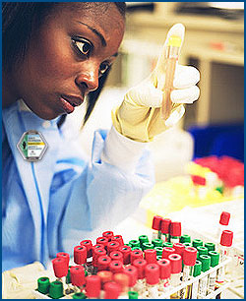
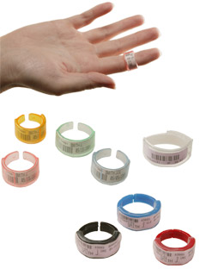
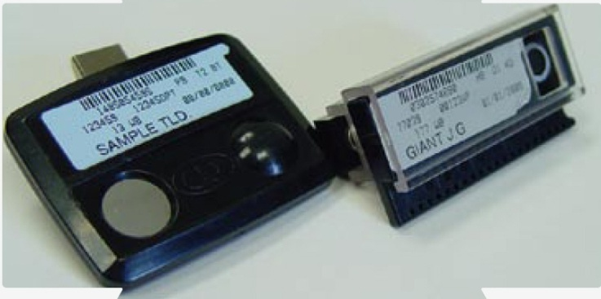
Worker Monitoring Badges
Measures whole body exposure to radiation, some may get ring dosimeter for P-32 / I-125
Not given for H-3, C-14, S-35, P-33, Ca-45
If lost or damaged, notify RSO for replacement

Slide 12
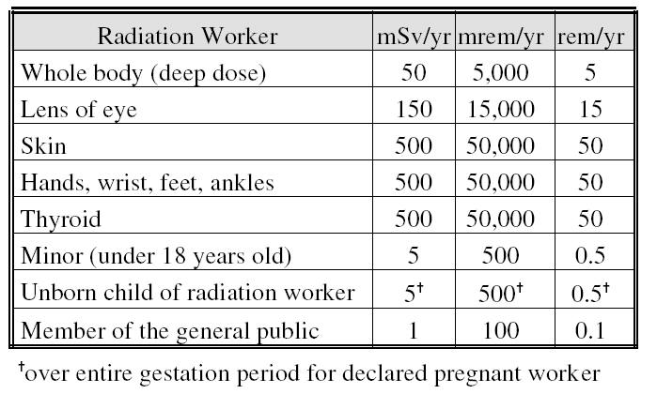
Radiation Exposure Limits
Most workers do not need badges, must handle > 1 mCi of high-energy beta (P-32) or gamma-ray (Cr-51, I-125) emitter
Average USD dose -- ~ 0 – 10 mrem/yr

Slide 13
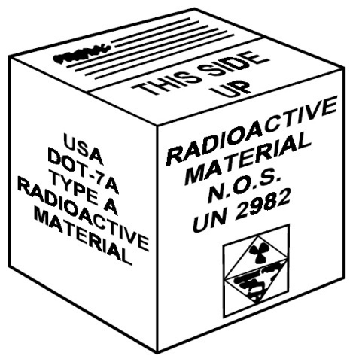
Radioactive Material Order
Notify RSO of desired order to be placed with Campus Chemical Storeroom.
Safety will check-in package, do radiation survey, assign inventory tracking number, and deliver to lab
Lab completes use log

Slide 14
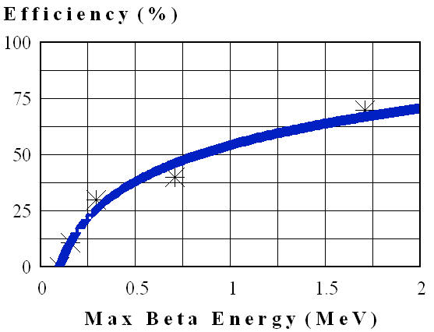
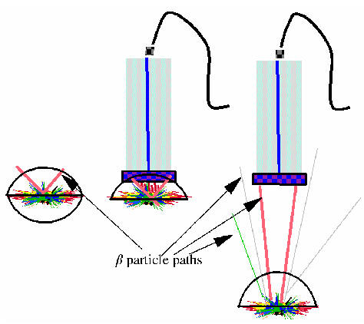
Lab Survey Considerations
GM Energy vs Efficiency
  Higher energy (P-32) more penetrating, higher detection efficiency
  Low energy (C-14, S-35), lower detection efficiency
Distance
  Follows inverse square law
  Measure at 1 cm for good results

Slide 15
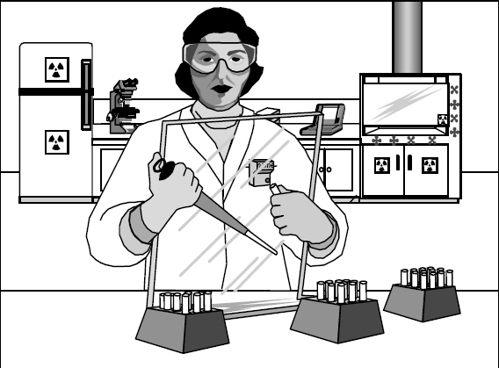
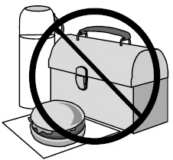
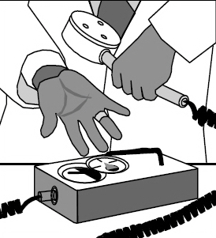
Radioactive Material Work
Protective clothing
  Gloves
  lab coat
  protective eyewear
No food or drink in labs
Survey work area and self with geiger counter after each use
Wash up before doing non-rad work

Slide 16
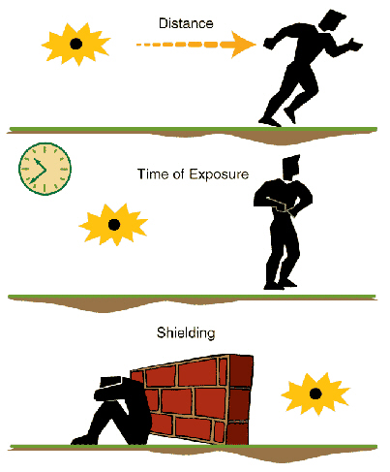
Radiation Safety
As Low as Reasonable Achievable (ALARA)
  Distance – keep distance, if you double distance, exposure decreases by 4 (inverse square law)
  Time – spend less time
  Shielding – plastic for beta (1/3”), lead for gamma

Slide 17
Radioactive Waste
Keep separate by radioactive element
Can decay short-lived (i.e., T_{½} < 120 days) in lab
EHS collects long lived
EHS will collect waste if desired
Solids in cardboard boxes, liquids in plastic jugs
May sewer small amounts
Report on inventory

Slide 18
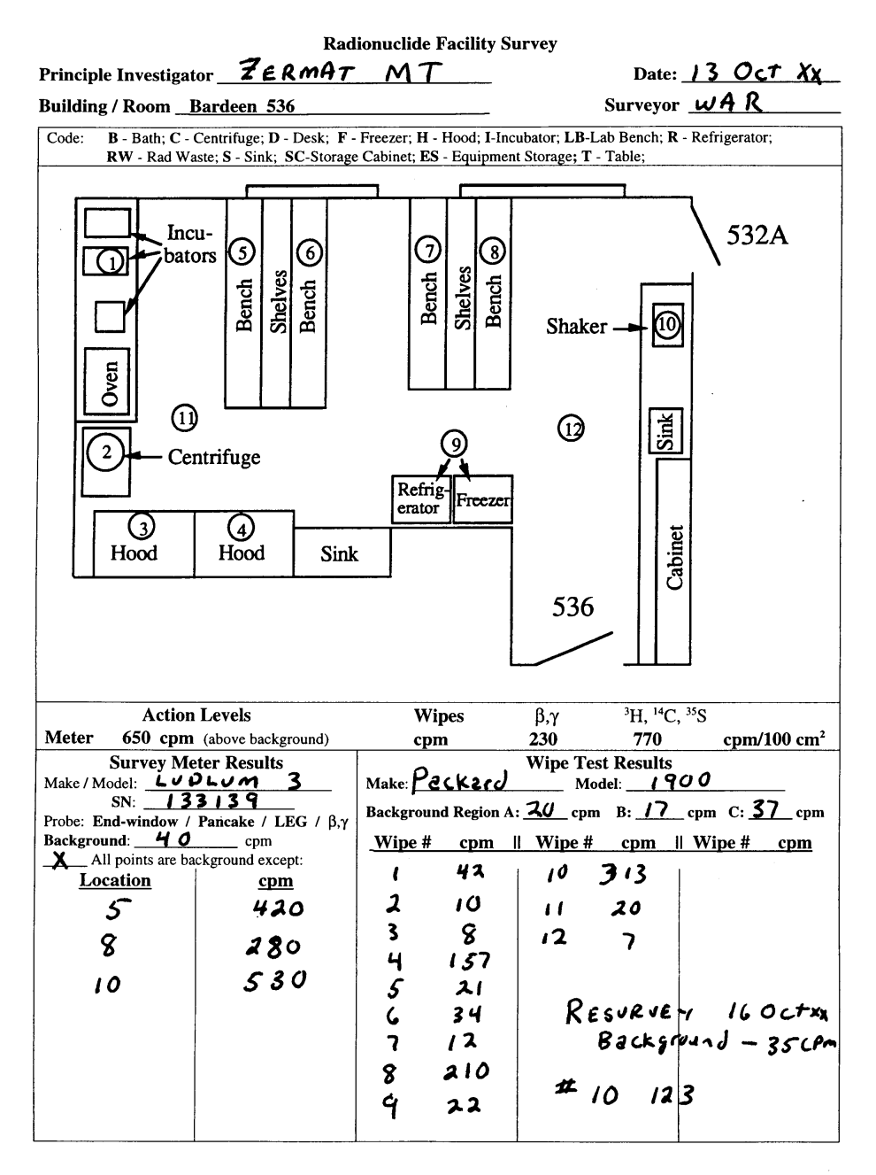
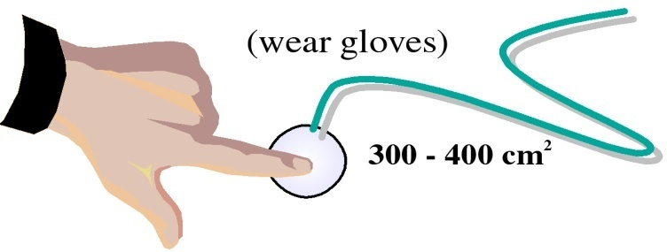
Monthly Radiation Surveys
Monthly, in any month for which radioactive materials are used / stored
Survey meter & wipe survey
Action level (clean if over):
  Meter: > 100 – 200 cpm
  Wipe: > 100 cpm
Submit results to RSO
Document in Binder to stored in the lab

Slide 19
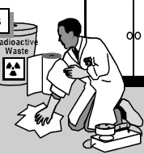
Emergencies
Medical attention takes precedence
Do not get exposed to get equipment
Prevent spread of contamination
Serious Injury / big Spill
  Call SD Mines Campus Safety (605-394-6100)
  Call RSO (605-394-6020)
Minor spill (most spills)
  Notify co-workers
  Monitor self & others
  Wear protective clothing
  Identify (survey) spill
  Spray decontaminant on spill and clean with absorbent pads
  Meter to verify results
  Lastly survey yourself
  Send report to RSO

Slide 20
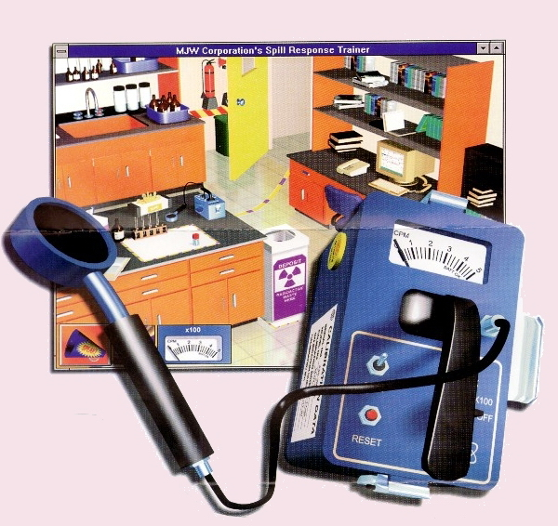
Radiation Safety Training
Take the online test to complete training.

